Slide 1
Module 5-2

Slide 2
Database Namespaces
Redis has multiple databases (namespaces)
Each database is like a separate storage box
DB 0 → Box 1
DB 1 → Box 2
DB 2 → Box 3

Slide 3
Database Namespaces
Default database (DB 0)
SET greeting hello
GET greeting
Output:
hello
Stored in DB 0

Slide 4
Database Namespaces
Switch to another database
SELECT 1
you are in DB 1
Try to access same key
GET greeting
(nil)
Because DB 0 data is NOT visible in DB 1
Store value in DB 1
SET greeting "guten tag"
DB 0 → greeting = hello
DB 1 → greeting = guten tag

Slide 5
Database Namespaces
Store value in DB 1
SET greeting "guten tag"
DB 0 → greeting = hello
DB 1 → greeting = guten tag
Move key to another database
MOVE greeting 2
Move "greeting" from current DB1 → DB 2
SELECT 2
GET greeting
DB 2 → greeting = guten tag
MOVE works only if key does NOT exist in target DB

Slide 6
Database Namespaces
Why this is useful?
Language example
DB 0 → English → hello
DB 1 → German → guten tag
DB 2 → French → bonjour

Slide 7
Telnet in Redis
Telnet is a networking tool used to connect to a server over TCP/IP using an IP address and port number.
In Redis, Telnet can be used to directly communicate with the Redis server (default port 6379) without using the redis-cli interface.
Unlike redis-cli, Telnet shows the raw communication format used by Redis, known as RESP (Redis Serialization Protocol).
This helps in understanding how Redis internally processes commands and returns responses.

Slide 8
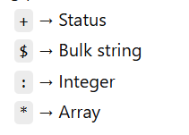
Telnet in Redis
Important Key Terms
RESP (Redis Serialization Protocol) The internal communication format used by Redis between client and server. It represents data types using prefixes like:
Telnet
A tool to directly connect to Redis and view raw RESP output.
redis-cli
A user-friendly interface that converts commands into RESP and formats output for easy reading.

Slide 9
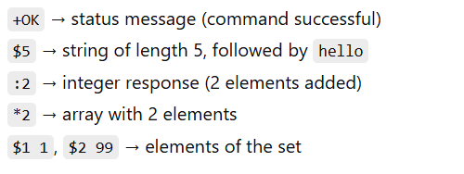
Telnet in Redis
Example using Telnet
$ telnet localhost 6379
Trying 127.0.0.1...
Connected to localhost.
Escape character is '^]'.
SET test hello
+OK
GET test
$5
hello
SADD stest 1 99
:2
SMEMBERS stest
*2
$1
1
$2
99
CTRL + ]

Slide 10
Telnet in Redis
CRLF (\r\n) -Carriage Return + Line Feed
CRLF stands for Carriage Return and Line Feed.
It is used to mark the end of a command in Redis communication.
Every command sent through Telnet must end with \r\n, which is equivalent to pressing the Enter key.
It tells Redis that the command is complete and ready to be processed.
Example-
hello\r\nhii
hello → printed
\r → cursor goes to beginning
\n → move to next line
hii → printed on next line
Output-
hello
Hii
Telnet example didn't show \r\n BUT internally it was always used when we use enter key
Thing | Meaning | Purpose
CTRL + ] | Telnet escape key | Exit Telnet
\r\n (CRLF) | End of line | Finish command

Slide 11
Pipelining
Sending Redis commands without redis-cli, using a tool called netcat (nc).
telnet → interactive (type one by one)
nc → send commands programmatically (script style)

Slide 12
Pipelining
Example
(echo -en "ECHO hello\r\n"; sleep 1) | nc localhost 6379
Sends this to Redis: ECHO hello
-e → allows special characters
\r\n → CRLF (compulsory for Redis)
sleep 1 → Give Redis time to respond - keep the connection open for one second after sending the command.
Output-
$5
hello

Slide 13
Pipelining
Pipelining
Send MANY commands at once → get all responses together
Example (Pipelining)
(echo -en "PING\r\nPING\r\nPING\r\n"; sleep 1) | nc localhost 6379
sending:
PING
PING
PING
All at once (single request)
Output
+PONG
+PONG
+PONG

Slide 14
Publish–Subscribe
Publish–Subscribe is a messaging communication model where a sender (publisher) sends messages to a channel, and multiple receivers (subscribers) receive those messages simultaneously.
It is used for:
Real-time notifications
Chat systems
Live updates

Slide 15
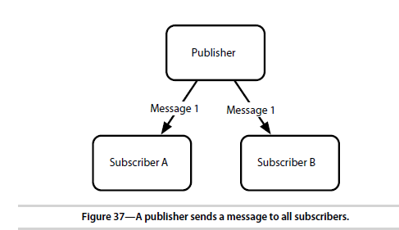
Publish–Subscribe

Slide 16
Publish–Subscribe
Important Characteristics
Decoupled system
Publisher does not know subscribers
Subscribers do not know publisher
Real-time communication
Messages are delivered instantly
No storage
Messages are NOT saved in Redis
If subscriber is offline → message is lost

Slide 17
Publish–Subscribe
Basic Commands
Command | Purpose
SUBSCRIBE channel | Subscribe to a channel
PUBLISH channel message | Send message
UNSUBSCRIBE channel | Leave channel

Slide 18
Publish–Subscribe
2. Start Another Subscriber (Client 2)
SUBSCRIBE news
Example
1. Start Subscriber (Client 1)
SUBSCRIBE news
Output-
1) "subscribe"
2) "news"
3) (integer) 1
3. Publisher sends message
PUBLISH news "Breaking News: Redis is fast!“
Output: 2 - 2 subscribers received the message
4. Message received by subscribers
Both clients will get:
1) "message"
2) "news"
3) "Breaking News: Redis is fast!"
5. Unsubscribe
UNSUBSCRIBE news
Stops receiving messages

Slide 19
Redis Configuration
daemonize → run in background or not
port → where Redis runs (default 6379)
loglevel → how much logs
logfile → where logs are stored
databases → number of DBs (default 16)
no → don't run in background
verbose → show detailed logs
stdout → print logs on screen
daemonize no
port 6379
loglevel verbose
logfile stdout
database 16

Slide 20
Master–Slave Replication
One Redis server (Master) → sends data to other servers (Slaves)
Master → handles writes (SET, SADD, etc.)
Slaves → copy data (read-only copies)
Master
redis-server - Runs on: port 6379
Slave config
cp redis.conf redis-s1.conf
port 6380 slaveof 127.0.0.1 6379
redis-server redis-s1.conf
One master, many slaves.
Master handles writes.
Slaves replicate data.
Slaves are read-only
port 6380
Run another Redis server on different port
slaveof 127.0.0.1 6379
This server becomes slave of master at 6379

Slide 21
Data Dump
Inserting a LARGE amount of data into Redis
Example:
2.5 million book records
Key = ISBN
Value = Book Title
Goal- Load huge dataset into Redis FAST

Slide 22
Data Dump
Method 1: Simple Insertion (Slow)
$redis.set(isbn, title)
For every line in file:
Read data
Insert using SET
~2.4 million records → 266 seconds
Why slow?
Each SET = separate request to Redis
Too many network calls → slow

Slide 23
Data Dump
Method 2: Using Pipelining (Fast)
Instead of sending one command at a time:
Send 1000 commands together
Batch + Pipeline = faster insertion
Step 1: Store lines in batch
batch << line
Step 2: When batch = 1000
flush(batch)

Slide 24
Data Dump
Method 2: Using Pipelining (Fast)
Step 3: Pipeline execution
$redis.pipelined do
batch.each do |line|
$redis.set(isbn, title)
end
end
~2.6 million records → 79 seconds
Normal mode = thousands of requests/sec
Pipeline mode = tens of thousands/sec

Slide 25
Redis Cluster
Store data across MULTIPLE Redis servers
Not like replication (copying), but:
Split data between servers
Setup
You have 2 Redis servers:
Server 1 → port 6379
Server 2 → port 6380
Both are masters (no slave here)

Slide 26
Redis Cluster
Step 1: Import distributed library
require 'redis/distributed‘
Work with multiple Redis servers as ONE system
Step 2: Connect both servers
$redis = Redis::Distributed.new([
"redis://localhost:6379/",
"redis://localhost:6380/"
])
Client sees both servers as one cluster

Slide 27
Redis Cluster
Client decides where to store data
Using consistent hashing
Key → hashed → assigned to one server
Key (ISBN) | Stored in
123 | Server 6379
456 | Server 6380
789 | Server 6379

Slide 28
Redis Cluster
Insert
$redis.set(isbn, title)
Internally- Client decides:→ which server to store this key
GET- $redis.get(isbn)
Client again: Calculates → which server has this key
→ fetches from correct server
This approach improves scalability and performance by spreading data across multiple nodes.

Slide 29
Bloom Filter
It is a fast checking system:
Check if a word is ALREADY used or NOT
If it says NOT present → 100% correct If it says PRESENT → maybe correct
Instead of searching millions of words → quick check
Example
Millions of book titles
Check if a word is unique

Slide 30
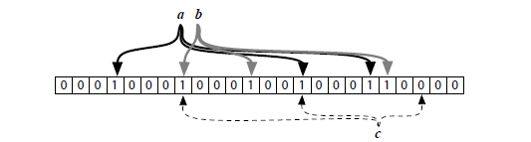
Bloom Filter
How it works
A big array of 0s and 1s (bits)
word → converted to some positions → set those bits = 1
Example:
"book" → positions 2, 5, 9 → set to 1

Slide 31
Bloom Filter
How it works
When checking a word
Check same positions
If ANY position = 0
→ word is NOT present (100% sure)
If ALL positions = 1
→ word MAY be present

Slide 32
Bloom Filter
Bloom Filter Code
require 'rubygems'
require 'bloomfilter-rb'
# Create Bloom Filter (stored in Redis)
bloomfilter = BloomFilter::Redis.new(:size => 1000)
# ---------------------------
# Example with "apple"
# ---------------------------
# Insert word
bloomfilter.insert("apple")
puts "Inserted: apple"
# Check words
if bloomfilter.include?("apple")
puts "apple → MAY be present"
else
puts "apple → NOT present"
end
if bloomfilter.include?("banana")
puts "banana → MAY be present"
else
puts "banana → NOT present"
end
apple → hash → positions (example: 3, 10, 25)
→ set bits = 1
Check "apple"
bloomfilter.include?("apple")
positions 3, 10, 25 → all = 1 → true
apple → MAY be present
If any position = 0:
apple → NOT present

Slide 33
Redis’s Strengths
Key strengths of Redis, emphasizing its speed, data structures, durability options,
and replication features:
1. Speed
• In-memory storage makes Redis extremely fast for read and write operations.
• This speed is especially advantageous for real-time applications (e.g., caching,
session management, leaderboards).
2. Rich Data Types:
• Unlike many simple key-value stores, Redis supports complex data structures,
including: Lists, Hashes, Sets, Sorted sets.
• Redis also provides specialized operations for each datatype, allowing for
powerful and efficient manipulation of data (e.g., pushing/popping from lists, set
operations like union/intersection, etc.).

Slide 34
Redis’s Strengths
3. Flexible Durability Options:
• Redis offers a spectrum of durability settings, allowing users to balance
between speed and data safety:
• Snapshotting Periodic saves of the dataset.
• Append-only file (AOF): Logs every write operation for more frequent backups.
• These options allow fine-tuning how much performance you're willing to trade
for reliability.
4. Built-in Replication
• Redis supports master-slave replication out of the box:
• Improves durability: If the master fails, a slave can take over.
• Enhances read scalability: Slaves can handle read traffic, reducing the load on
the master.
• This is especially useful for read-heavy systems, such as real-time analytics
dashboards or content delivery systems.

Slide 35
Redis’s Weaknesses
weaknesses of Redis, primarily related to memory usage, durability, and scalability:
1. In-Memory Design (Speed vs. Durability):
• Redis is extremely fast because it stores all data in memory (RAM).
• However, this speed comes at the cost of durability:
• If Redis is shut down before a snapshot is taken, data can be
lost.
• Even with append-only file (AOF) syncing every operation, there's still risk—especially with expiry times, which may not replay identically after a crash.
2. Volatile Data Due to Time-Based Events:
• Time-sensitive keys (e.g., those with EXPIRE or TTL) may not
behave the same when restored, leading to inconsistent state after a
recovery.

Slide 36
Redis’s Weaknesses
3. Memory Limitations: Redis can only store as much data as fits in
the machine's RAM. Support for virtual memory (swapping data to disk) has been removed, limiting use to in-memory datasets only.
4. Clustering and Scalability: While a Redis Cluster exists to allow
horizontal scaling, it's still under active development and may lack
features or stability. As of now, users must manually implement
clustering using client libraries that support it e.g., a Ruby client.

Slide 37
Polyglot Persistence
Practice of using multiple databases in a single application
Different data → use different database types
One database cannot efficiently handle all types of data
Advantages
Better performance
High scalability
Flexibility in design

Slide 38
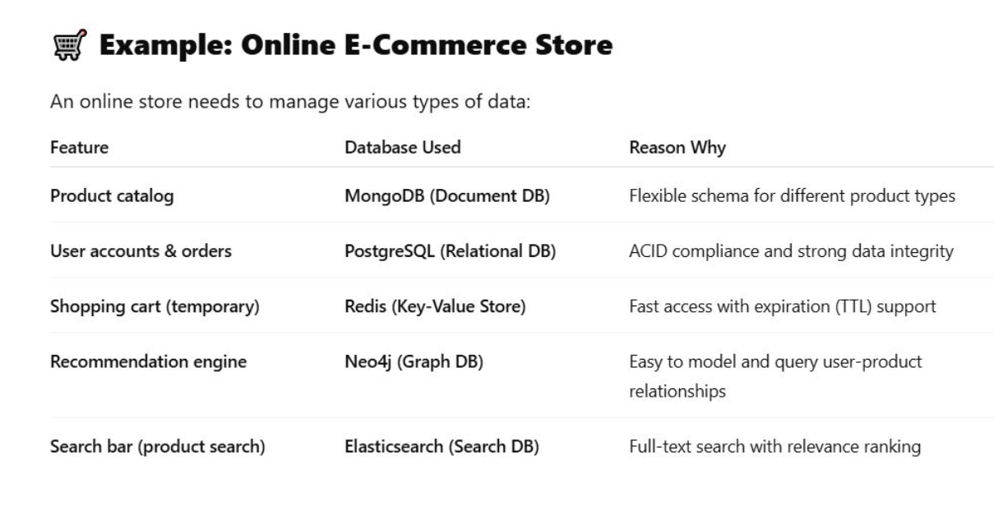
Polyglot Persistence

